Slide 1
Assignment 1.2 Irrational and Rational Numbers
© Copyright all rights reserved to Homework depot: www.BCMath.ca

Slide 2
Review) Square Root and Cube Root of a Number
When finding the square root of a number, do the opposite of “squaring” it
When cube rooting a number, find a number that is equal to it when cubed
Ex: Find the square root of each number

Slide 3
I) What is a rational number?
Any number that can be expressed as a quotient of two integers
This includes the following:
all fractions
all integers
all terminating decimals
all repeating decimals

Slide 4
II) What are irrational numbers?
Any number that CANNOT be expressed as a fraction with two integers is irrational
Both numerator &denominator need to be integers
Irrational numbers are non-terminating decimals
non-repeating decimals
In general, if it can be written as a fraction, with the numerator & denominator as fractions, then it won’t be irrational
If you take the square root of a non perfect square, cube root of a non perfect cube → irrational number

Slide 5
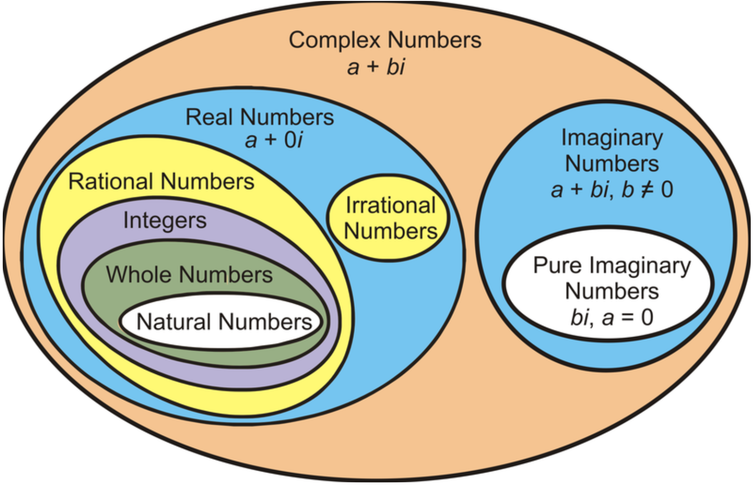
When you combine all rational numbers with irrational numbers, you get → REAL NUMBERS
Real numbers
Rational numbers
Irrational numbers
*In terms of radicals, unless ‘x’ is positive & a perfect square/cube, the root of ‘x’ is always irrational
Integers
Whole numbers
Natural numbers

Slide 6
Ex: Simplify each expression and Circle the rational numbers

Slide 7
III) Review: Perfect Squares
A number that is the square of another number
Square roots of “perfect squares” are integers
Ex: Indicate which of the following are perfect squares
If a number is not a perfect square, we can use PS to find the square root of that number
Largest P.S. that is smaller than 189
Smallest P.S. that is larger than 189
© Copyright all rights reserved to Homework depot: www.BCMath.ca

Slide 8
IV) Estimating Irrational Numbers
Ex: Given each roots, estimate the value and draw it on a number line:
Find two perfect square that 17 is in between
Place the values on a
Number line
© Copyright all rights reserved to Homework depot: www.BCMath.ca

Slide 9
Practice: Estimate the following Roots and draw it on a number line @
© Copyright all rights reserved to Homework depot: www.BCMath.ca

Slide 10
What are Radicals?
Radicals are numbers with a root sign or when the exponent is a fraction
Square Root → →
Cube Root → →
Forth Root → →
Higher Roots → →

Slide 11
III) n^{th} Root of a Number
Ex: Simplify each of the following without a calculator:

Slide 12
v) Estimating Square Roots of Fractions
There are several ways to estimate the square root of fractions
All methods are estimates and never completely exact
1st Method:
Round the numerator and denominator each to its nearest perfect square
© Copyright all rights reserved to Homework depot: www.BCMath.ca

Slide 13
Estimate the following square roots
© Copyright all rights reserved to Homework depot: www.BCMath.ca

Slide 14
2nd Method: Multiply the numerator and denominator by a common number so that each value will be closer to a perfect square
We know that our answer should be a bit bigger that 1.8
because we rounded 85 down to 81
Therefore, our estimate would
be approximately 1.82 to 1.85
© Copyright all rights reserved to Homework depot: www.BCMath.ca

Slide 15
Estimate the following square roots
© Copyright all rights reserved to Homework depot: www.BCMath.ca

Slide 16
Challenge: Given the first nine decimal value of 1/19, find the decimal expansion of 3/19 (Note: do this without a calculator)

